Slide 1







Bank Loan Risk & Credit Analysis
PORTFOLIO PERFORMANCE STRATEGY
FINANCIAL ANALYTICS DEPT.Q3 2024

Slide 2
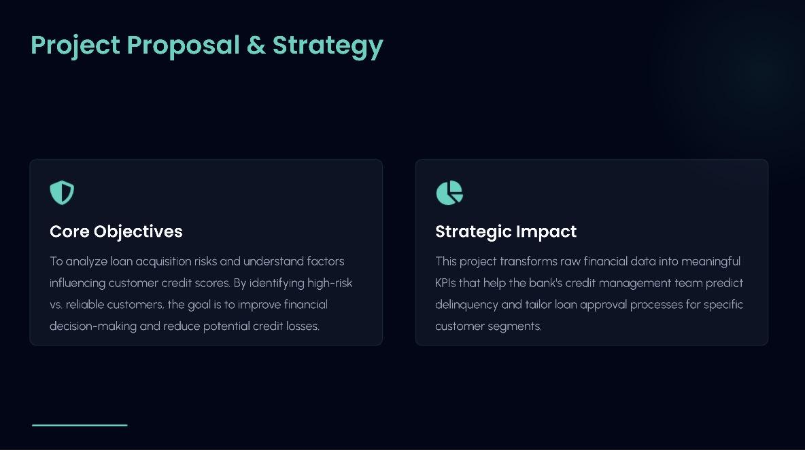

Slide 3
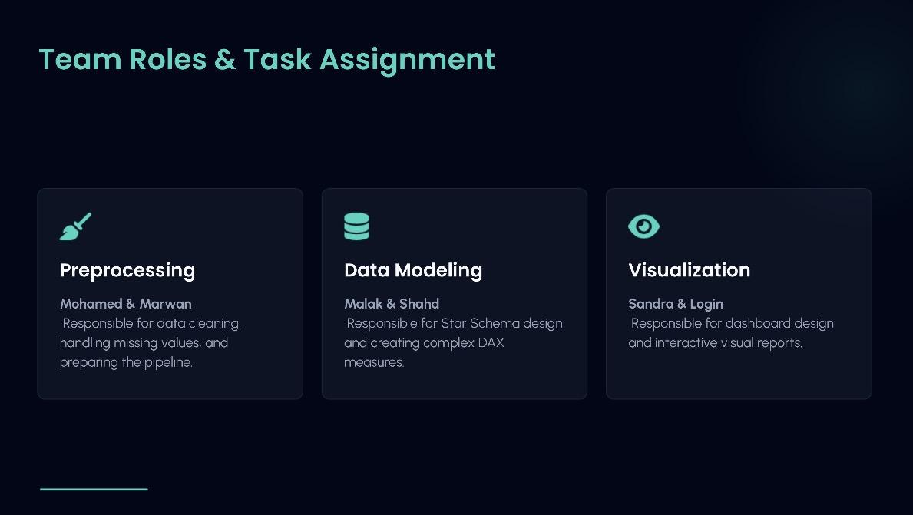

Slide 4


Portfolio High-Level KPIs
31.19bn
312.50k
22.64%
TOTAL LOAN AMOUNT
AVG LOAN AMOUNT
CHARGED OFF RATIO
The current portfolio shows a healthy total volume, but risk management is critical given that nearly 23% of loans are charged off.
STRATEGIC OVERVIEWPAGE 02

Slide 5
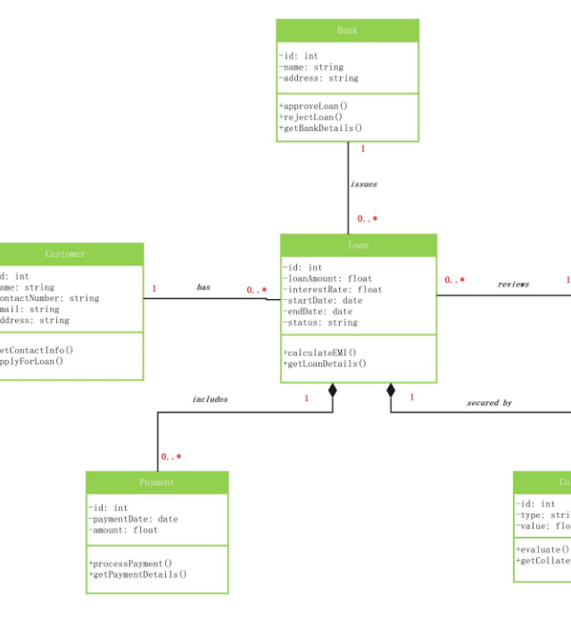
Robust Star Schema
Data Architecture
Our solution utilizes a centralized fCredit fact table connected to optimized dimension tables for scalable reporting.
•
Fact Table: Metrics like Income, Balance, and Credit Score.
•
Dimension Table: Detailed customer profiles and ownership status.
•
Measures: Automated DAX calculations for risk ratios.

Slide 6
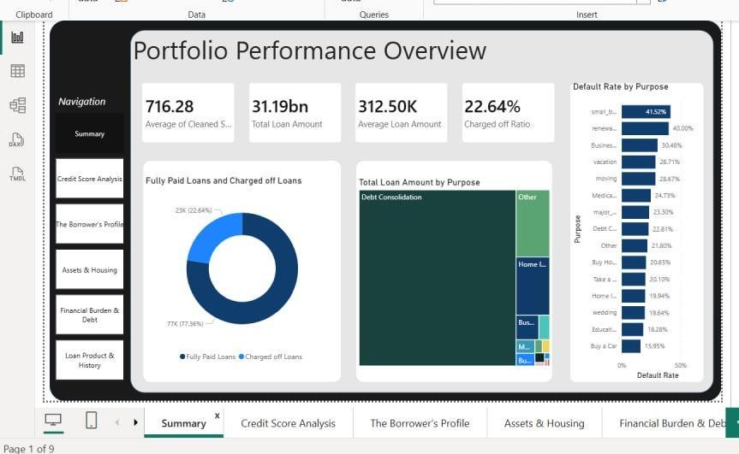

Slide 7

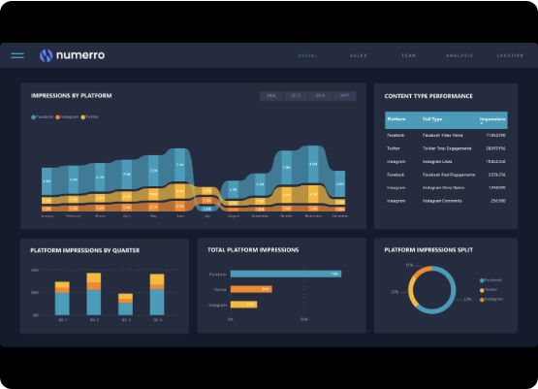
Interactive Analytics Dashboard
Unified Command Center
The dashboard provides real-time visibility into:
▪
Default rates by loan purpose.
▪
Geographic distribution of credit risk.
▪
Income vs. Debt ratio correlation.
▪
Historical delinquency trends.
PERFORMANCE MONITORINGPAGE 04

Slide 8
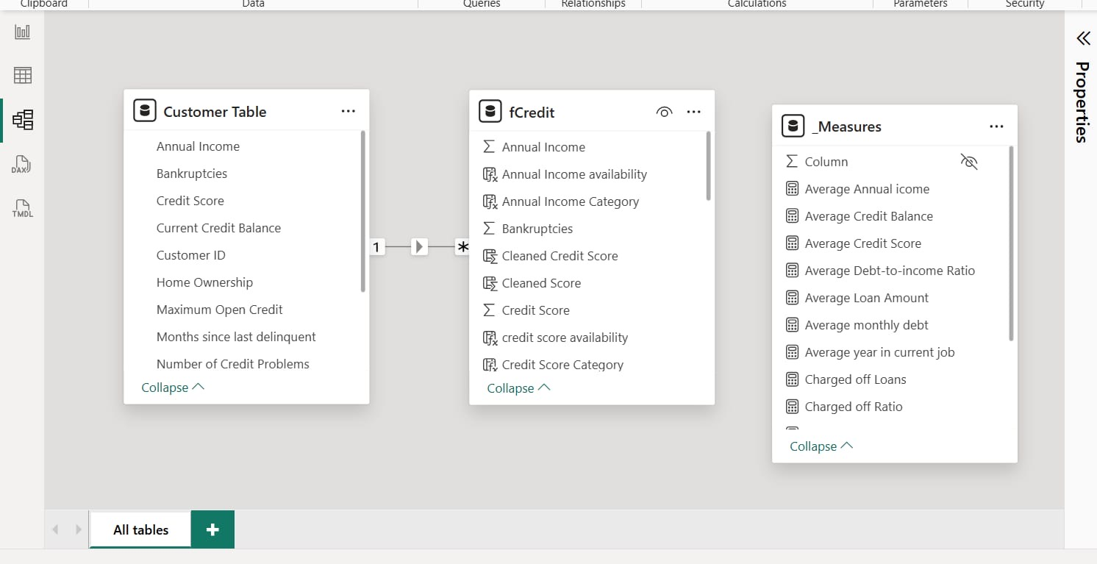

Slide 9






Seven Phases of Delivery
1. ETL Process
2. EDA Analysis
3. Modeling
Advanced data cleaning, handling missing values and duplicates.
Univariate and multivariate analysis for trend identification.
Structuring the star schema for optimal query performance.
WORKFLOW FRAMEWORKPAGE 05

Slide 10

Loan Status Breakdown
Default Impact Analysis
With 23K loans classified as "Charged Off", the financial impact reaches significant levels. High-risk segments need immediate policy adjustment.
Alert: Small Business loans show the highest risk profile.
■ Fully Paid (77.36%) ■ Charged Off (22.64%)
STATUS SEGMENTATIONPAGE 06

Slide 11
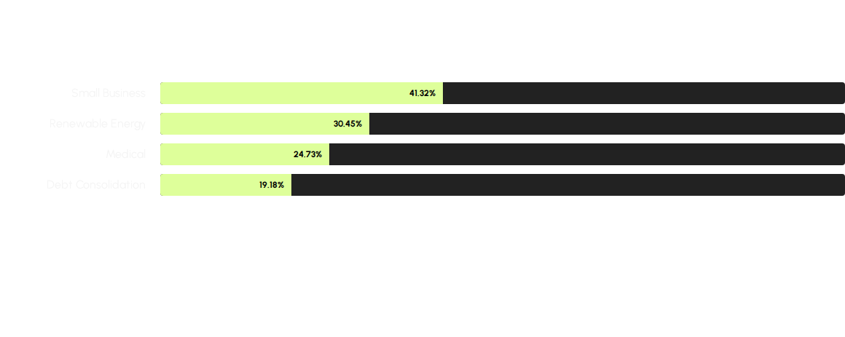
Default Rate by Purpose
Data reveals that Small Business loans are 1.8x more likely to default than the portfolio average.
SEGMENTED RISKPAGE 07

Slide 12





Risk Classification Matrix
Low Risk
Medium Risk
High Risk
Strong credit scores, long employment history, and low DTI. High approval priority.
Stable income but moderate credit utilization. Requires balanced monitoring.
History of delinquency and low credit score. Strict limits applied.
STRATEGIC SEGMENTATIONPAGE 08

Slide 13
Financial Metrics Table
Loan Type | Avg Annual Income | Avg Credit Balance | Risk Score
Personal Loan | $65,000 | $12,400 | Moderate
Small Business | $82,500 | $34,100 | Critical
Home Improvement | $91,000 | $18,900 | Low
Medical | $54,200 | $9,200 | High
DATA AUDITPAGE 09

Slide 14


Mitigation Strategies
Portfolio Rebalancing
Enhanced Screening
Shift focus toward Home Improvement and Vacation loans which demonstrate significantly lower default rates.
Implementing stricter credit score thresholds for applicants in the "Small Business" category.
Targeting a 15% reduction in Charged Off loans over the next fiscal year.
ACTION PLANPAGE 10

Slide 15


Mission Accomplished
Through data transparency and predictive modeling, we have created a roadmap for a more resilient and profitable lending portfolio.
FINAL SUMMARYPAGE 11

Slide 16

Questions?
Thank you for your attention.
PRESENTED BY THE RISK ANALYSIS TEAM
Mohamed H. | Marwan H. | Malak E. | Sandra B. | Shahd F. | Login T.
END OF PRESENTATIONPAGE 12

Slide 17




Image Sources
https://edrawmax.wondershare.com/templates/UML/class-diagram-for-bank-loan.jpg
Source: edrawmax.wondershare.com
https://cdn.prod.website-files.com/5efb0b7816032fd33ce6059c/62d5bbd6d01ba2d84d85e91f_Screen%20Shot%202021-10-07%20at%2012.36%20(1).png
Source: www.numerro.io
https://slidebazaar.com/wp-content/uploads/2022/09/Chart-Analysis-jpg.webp
Source: slidebazaar.com
https://i.redd.it/2abohxcffy1h1.jpeg
Source: www.reddit.com

